Slide 1
A Study on Blockchain Base for Students Marks Data Management Using PBFT Algorithm
MD. Nazmul Alam Khan
Reg.No : 47936
Session:2017-2018
Mumtahina Mim
Reg.No :48090
Session :2017-2018
Dr. Md. Humayun Kabir
Professor
Department of Computer Science
and Engineering
Sunday, 28 May, 2022

Slide 2
Presentation Outlines
Introduction
Objectives
Literature Survey
Existing Storage Management System
Some Blockchain Algorithms
PBFT Algorithm
Blockchain System model for Students Marks Management
Module Description
Result Analysis
Conclusion & Future Scope

Slide 3
Introduction
Some academic centers allow a quick and simple online query to verify the authenticity of student’s academic information without even asking who requires that information.
This leads to academic frauds and information stealing from the students and misusing it.
Hence Blockchain come in handy to store students information encrypted in the database.
Blockchain acts as a ledger system where data stored in a transparent and immutable format.
The PBFT algorithm is the key method to make the blockchain consistent.

Slide 4
Objectives
The main objective of the project the keyword dictionary sent by the data owner
The smart contract can perform the search algorithm according to the user’s query keywords, and return the abstract and encrypted keywords of the corresponding data file found.
After the query is completed, the transaction between the data owner and the user, that is, the query record can be published in the block chain.

Slide 5
Literature Survey
SlNo | Year | Title Of The Paper | Author | Description
1. | 2023 | Improved PBFT Consensus Algorithm Based on Node Role Division | Ren, X., Tong, X. and Zhang, W. | This paper discusses the core of the PBFT consensus algorithm that is composed of consistency protocol, checkpointing protocol, and view change protocol.
2. | 2023 | Improved PBFT Algorithm Based on Comprehensive Evaluation Model | Jiang, Wangxi, Xiaoxiong Wu, Mingyang Song, Jiwei Qin, and Zhenhong Jia | This paper discusses the difference between blockchain systems and traditional distributed systems is that the environment is complex, and Byzantine nodes will be introduced even in strict consortium blockchains, so research on the

Slide 6
Literature Survey
SlNo | Year | Title Of The Paper | Author | Description
3. | 2022 | Blockchain-based model to track and verify official certificates | Pooja Mara, Ravi kanth Motupalli | In this paper ,the Authors have developed a web-based application that is using Blockchain technology to store academic certificates to avoid certificate counterfeit as lots of fake certificates are being stolen and used to get jobs
4. | 2021 | Revolutionizing Verification and Management of Educational Certificates with Self-Sovereign Student Identities using Blockchain | Harshita Bhosale, Rutuja Kanki, Gayatri Jaiswal | In this paper, a framework which is a decentralized system is discussed.It performs a mechanism for the system to enable us to validate and track the operations performed by these institutions.

Slide 7
Existing storage management System
Centralized storage and management mode is usually adopted, which makes systems that use this mode vulnerable to various attacks.
The records of different educational stages are stored in separate storage servers of education institutions and these storage servers are usually designed to allow access only by internal staff
In this system, a server failure could easily cause a data loss or leakage

Slide 8
Some Blockchain Algorithms
Some Blockchain Algorithms:
Proof of Work (PoW)
Direct Acyclic Graph (DAG)
Practical Byzantine Fault Tolerance (PBFT)
Proof of Capacity (PoC)
Proof of Stake (PoS)
Advanced Encryption Standard (AES)

Slide 9
PBFT Algorithm
PBFT consensus rounds are broken into 4 phases(refer with the image in next slide):
The client sends a request to the primary (leader) node.
The primary (leader) node broadcasts the request to the all the secondary(backup) nodes.
The nodes (primary and secondaries) perform the service requested and then send back a reply to the client.
The request is served successfully when the client receives ‘m+1’ replies from different nodes in the network with the same result, where m is the maximum number of faulty nodes allowed.
The Communication complexity of the PBFT algorithm: C1= 2n ² − n+1

Slide 10
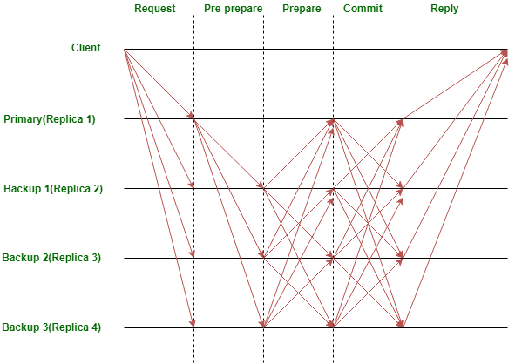
PBFT Algorithm

Slide 11
AES Algorithm
The AES algorithm is a symmetrical block cipher algorithm that takes plain text in blocks of 256 bits and converts them to ciphertext using keys of 128, 192, and 256 bits
SHA-256 in cryptographic hash function.
Uses 256 bit key to encrypt data into unrecognizable text.
Plain text (32 bits words)-Block size (256 bits)
No of rounds-10 –cipher text (256 bits)

Slide 12
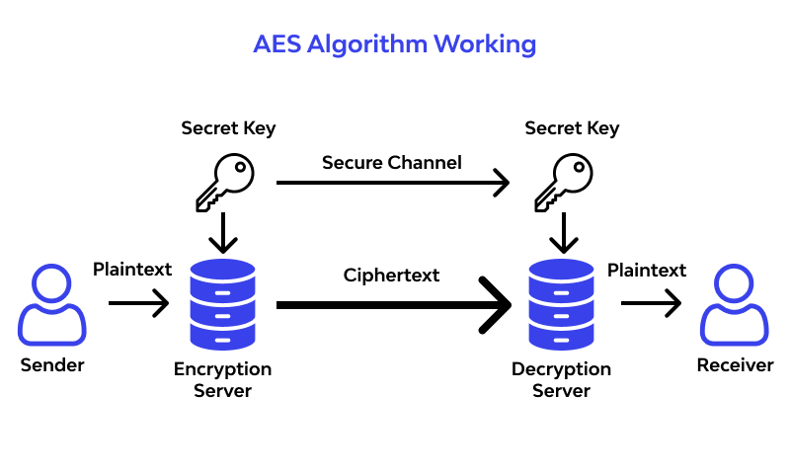
AES Algorithm

Slide 13
BlockChain System Model For Students Marks Management
The blockchain is responsible for ensuring the security and auditability of the data, the smart contract is used to define the permissions of the records and to regulate the behaviours of the member nodes
We remark that public blockchain is not suited in this case, because educational records are related to personal privacy and contain sensitive information, such as family address, age, contact details, etc.

Slide 14
BlockChain System Model For Students Marks Management (1)
Moreover, even if the institutions put encrypted data on the public blockchain, it still will expose their operation situations and statistical data.
We firstly use data masking for the part of the student’s private data and then encrypt it and store it on the server.
The user must have the authorization of the data owner to query the data, and the verification of the user’s authority is realized using a smart contract. Students can take their documents using Secret key from the server.

Slide 15
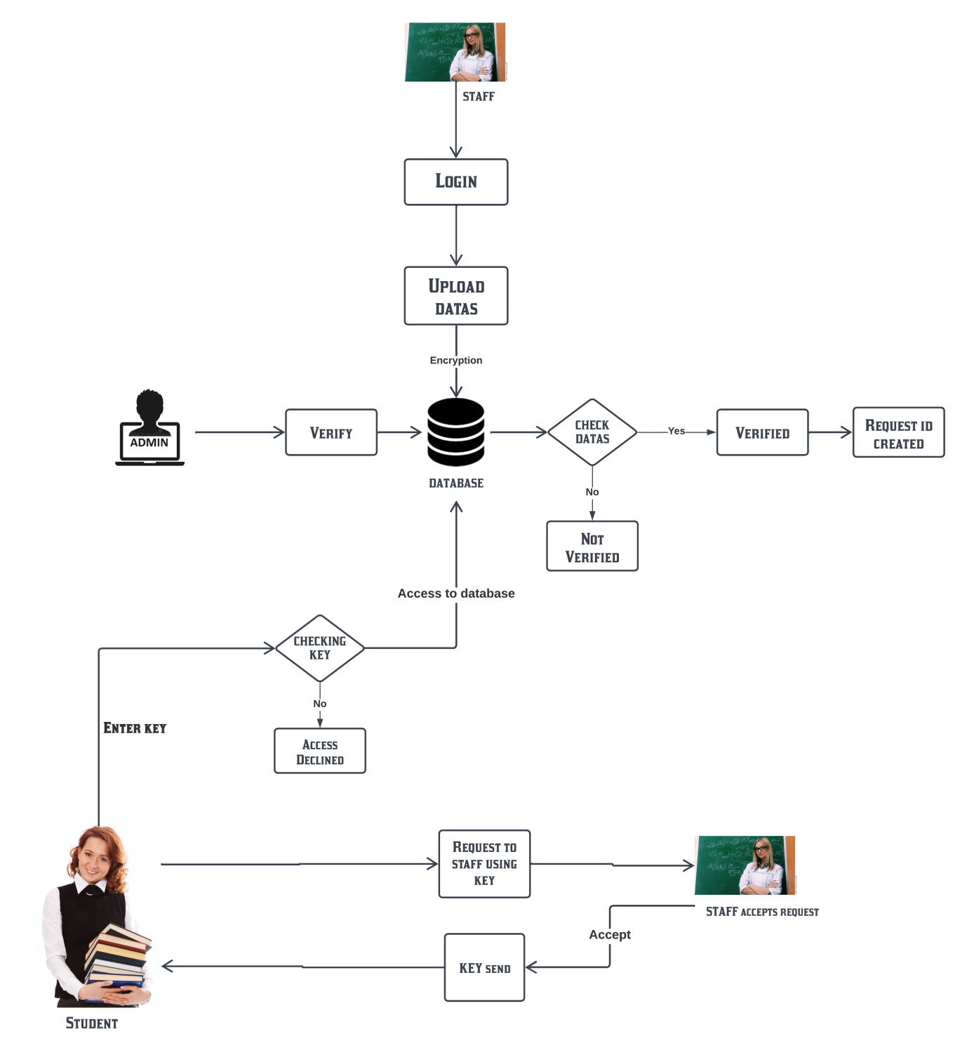
System Architecture
TEACHER
TEACHER ACCEPTS REQUEST

Slide 16
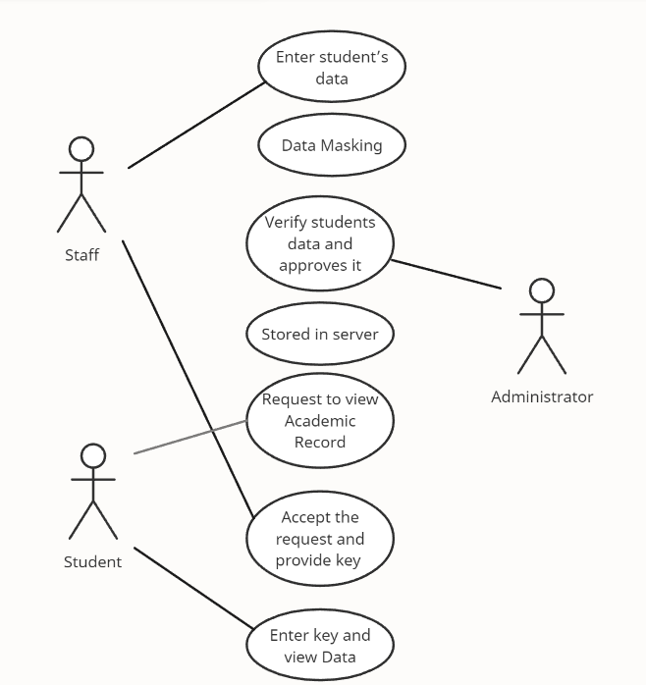
System Design – Use Case Diagram
Teacher
Student

Slide 17
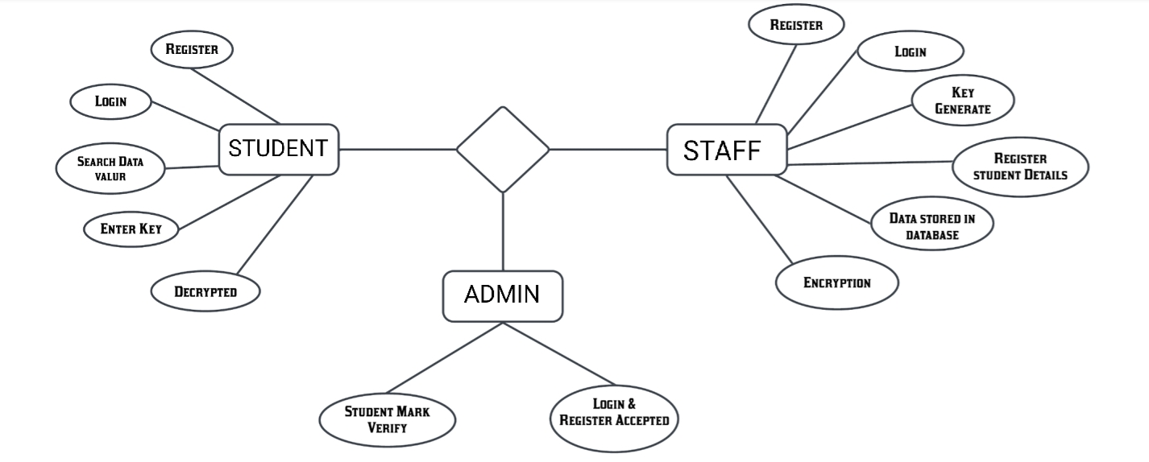
System Design – ER Diagram
TEACHER
STORE
STUDENTS MARKS

Slide 18
Module Description
Data Request
The Students Data that is entered and encrypted in the Blockchain Database can only be accessed through Secret Key.
Once the student sends Data access request, it then comes under teacher approval.
When the teacher gives approval, the respective secret key for that students data is sent to the student.

Slide 19
Module Description
Encrypted Data Storing
The encrypted data is stored in the storage server and their hash is put on the blockchain and keyword also generated for the each student for the security. The amount of data on student education records is huge.
For the transmission of big data used Encryption algorithm. The original records and files are encrypted and stored in the storage server. The blockchain database is chosen as the storage server to efficiently store and retrieve data and support encrypted storage of files.

Slide 20
Module Description
Data Access By Entering Key
After storing the data into the databases , that is then available in the server but the student have to enter the keyword for the accessing their data’s.
So, after entering the key, the student get access to the storage server and able take his documents easily.
The blockchain is applied in several domains and acts as a trusted data storage technology. This technology is often used for information secure storage and information traceability, because of its decentralized and anti-tampering characteristics.

Slide 21
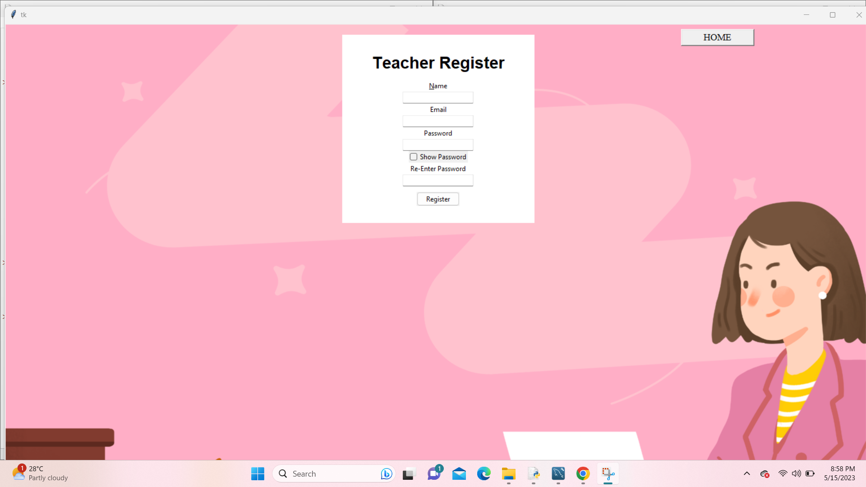
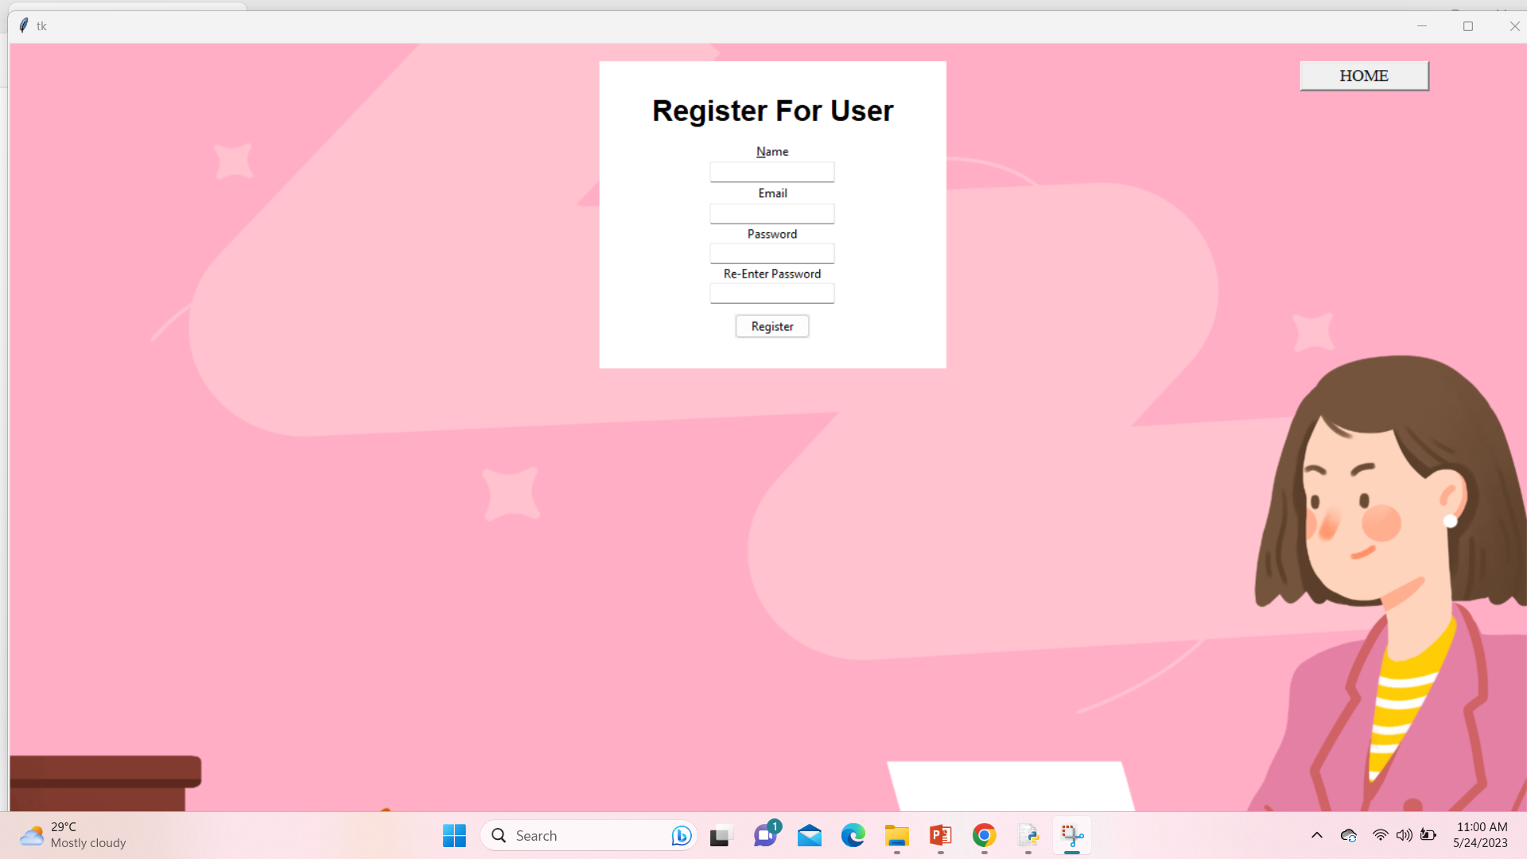
Result Analysis
Teachers & Users Create Account

Slide 22
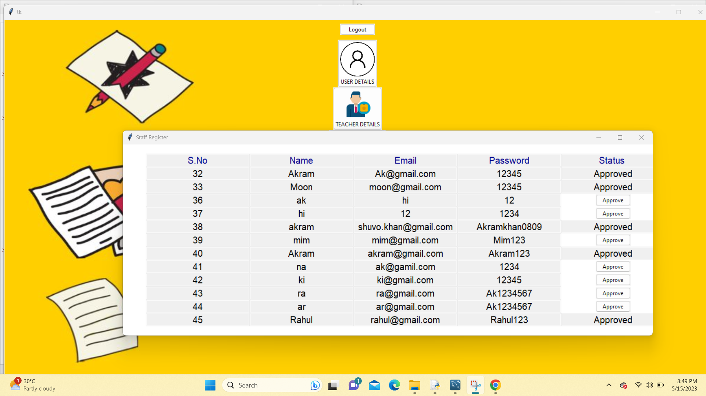
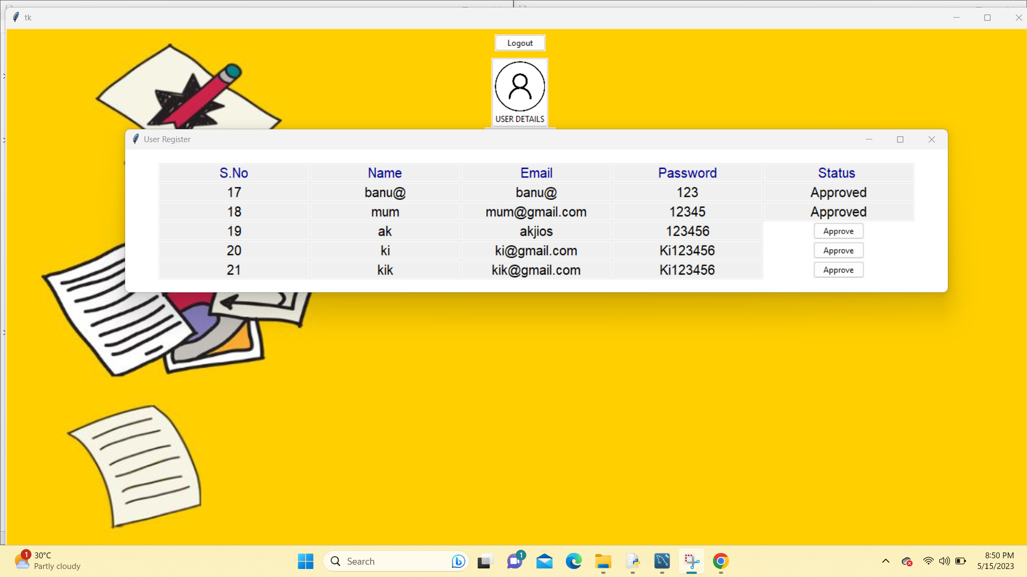
Result Analysis
Teacher’s Account Approved by admin
User’s Account Approved by admin

Slide 23


Result Analysis
Teacher login

Slide 24
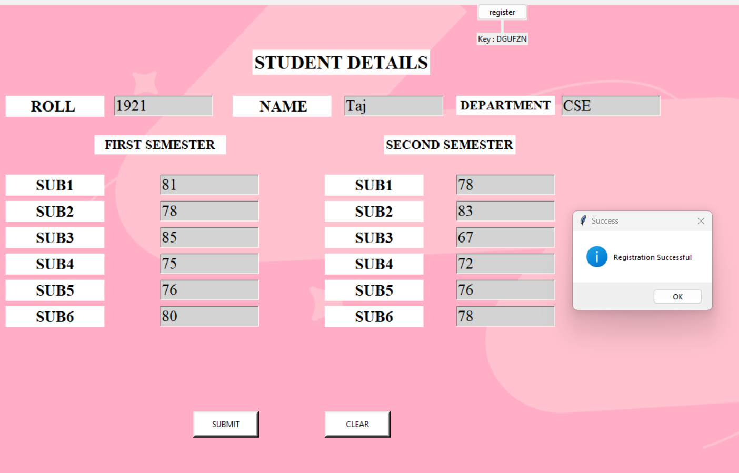
Result Analysis
Teacher Register student info & Submit Mark

Slide 25
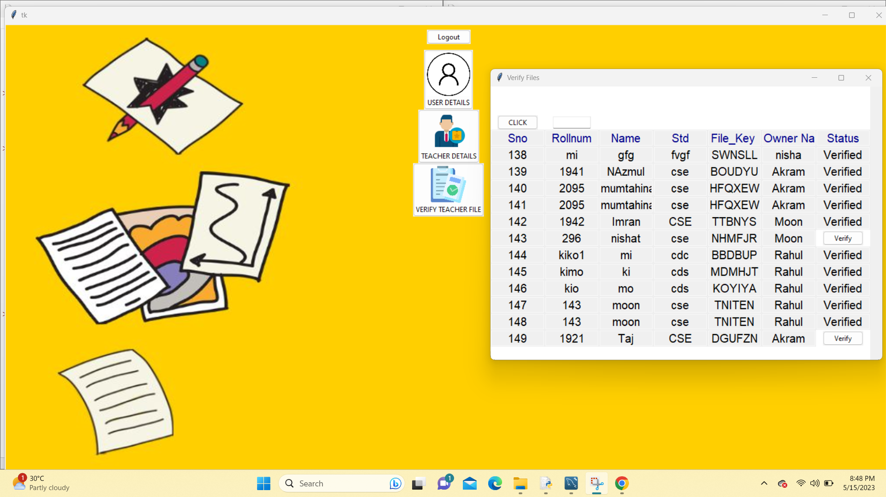
Result Analysis
Admin panel Approve Submitted mark file:

Slide 26
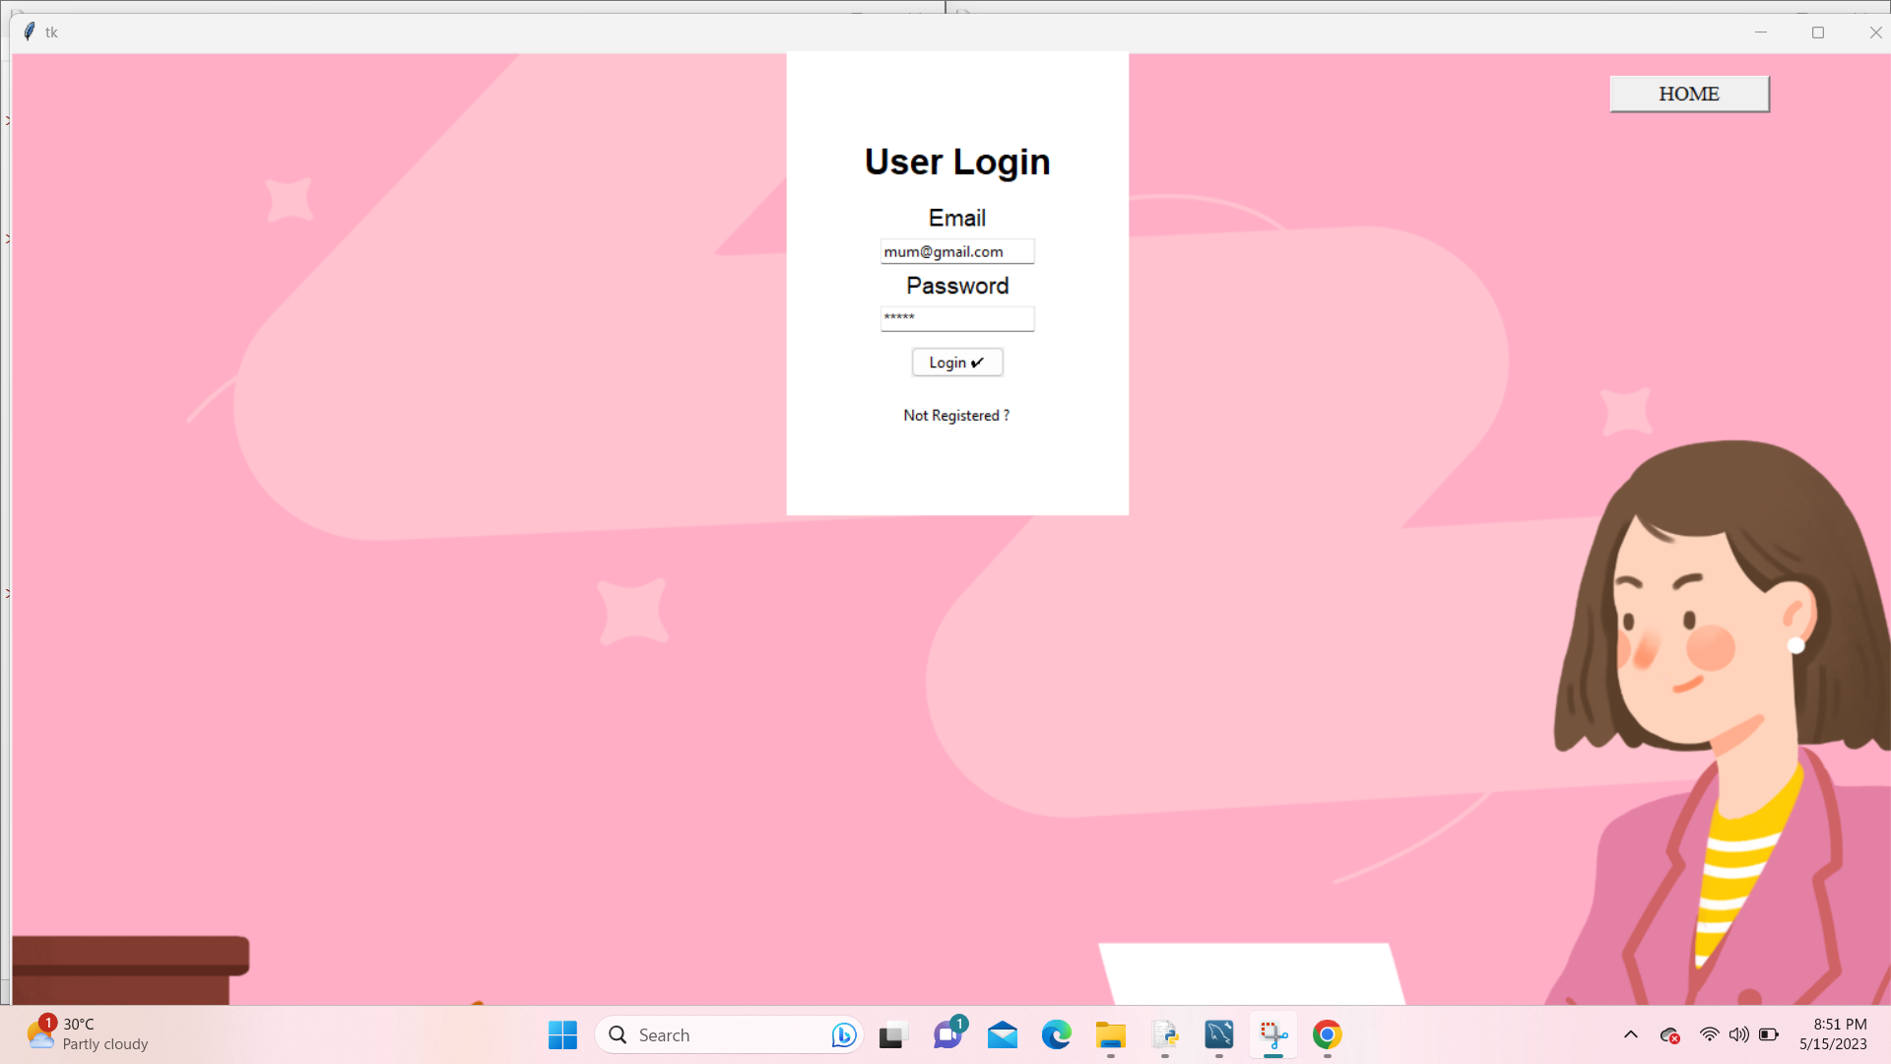
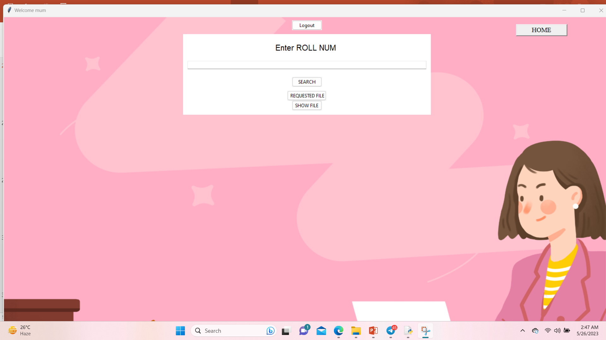
Result Analysis
User login

Slide 27
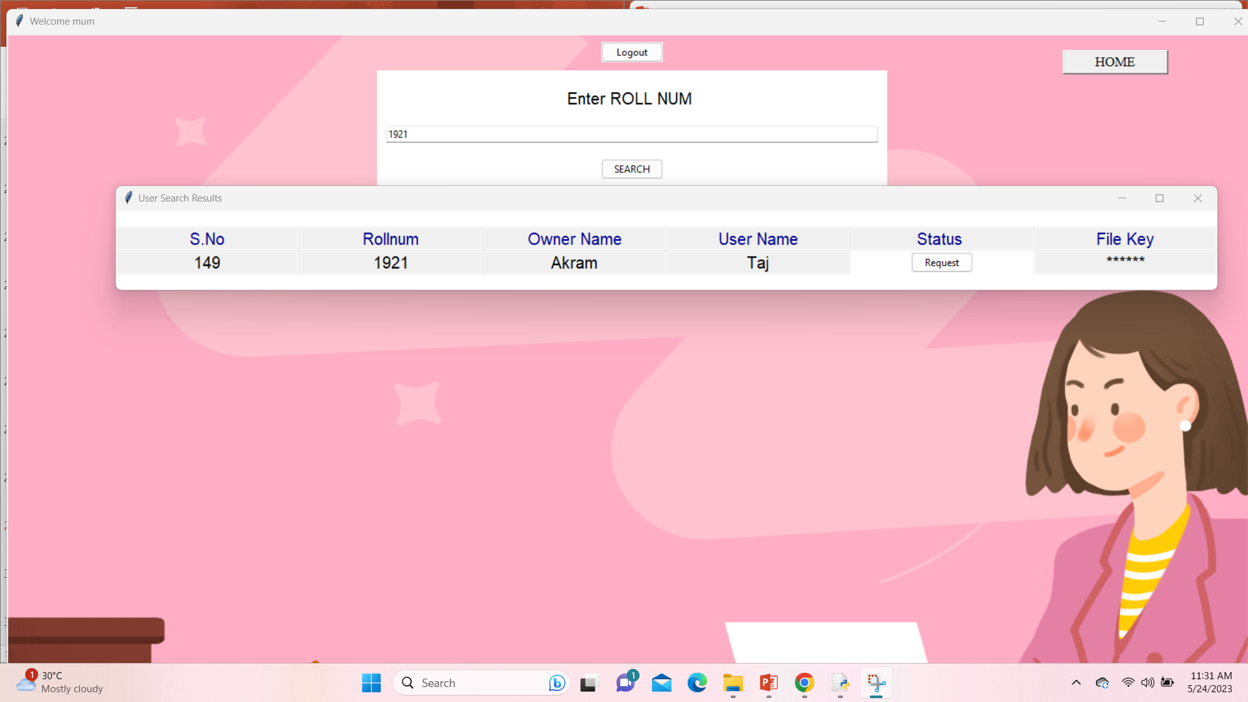
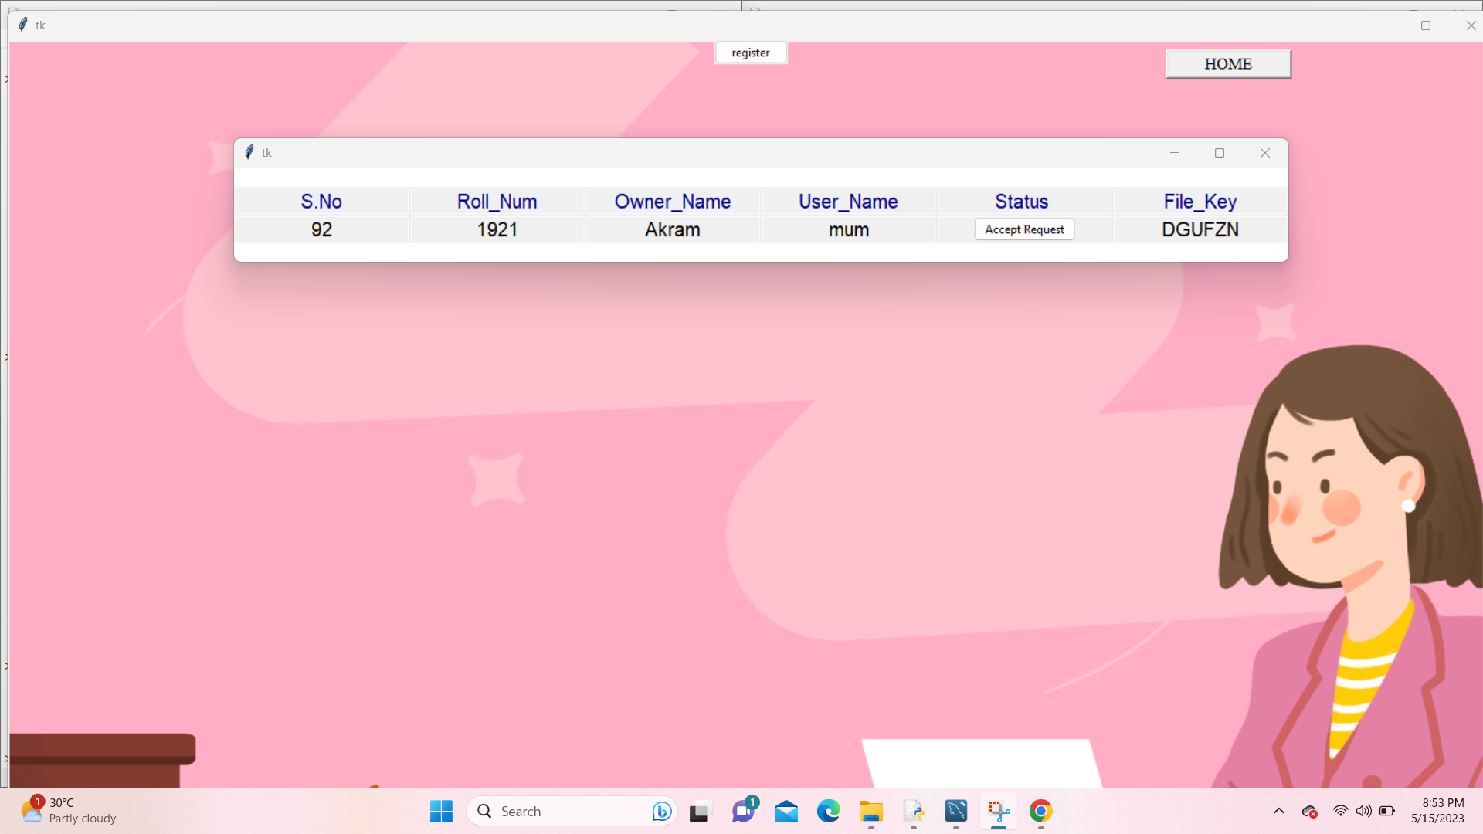
Result Analysis
Search academic data
Teacher provides access & key sent to user

Slide 28
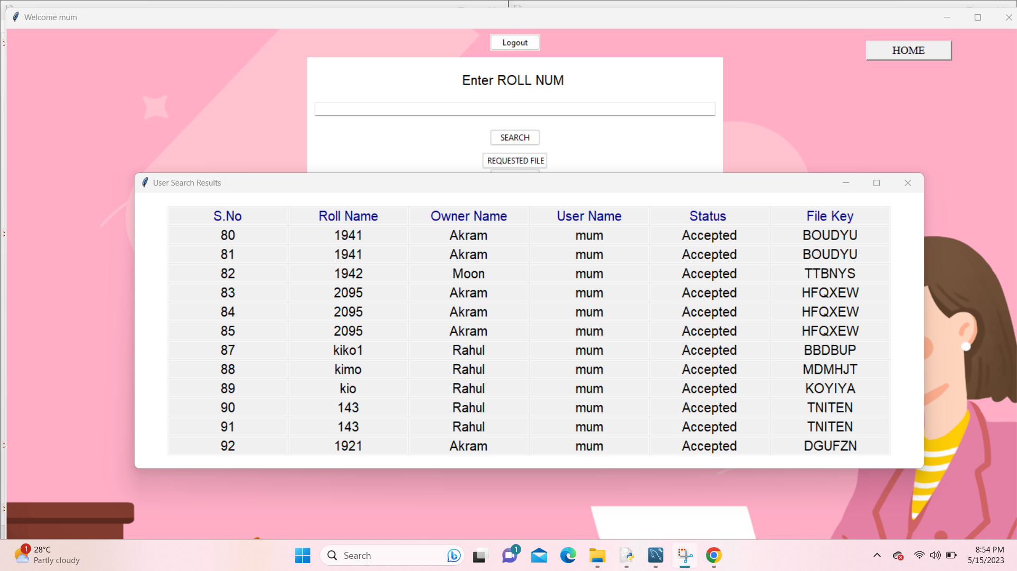
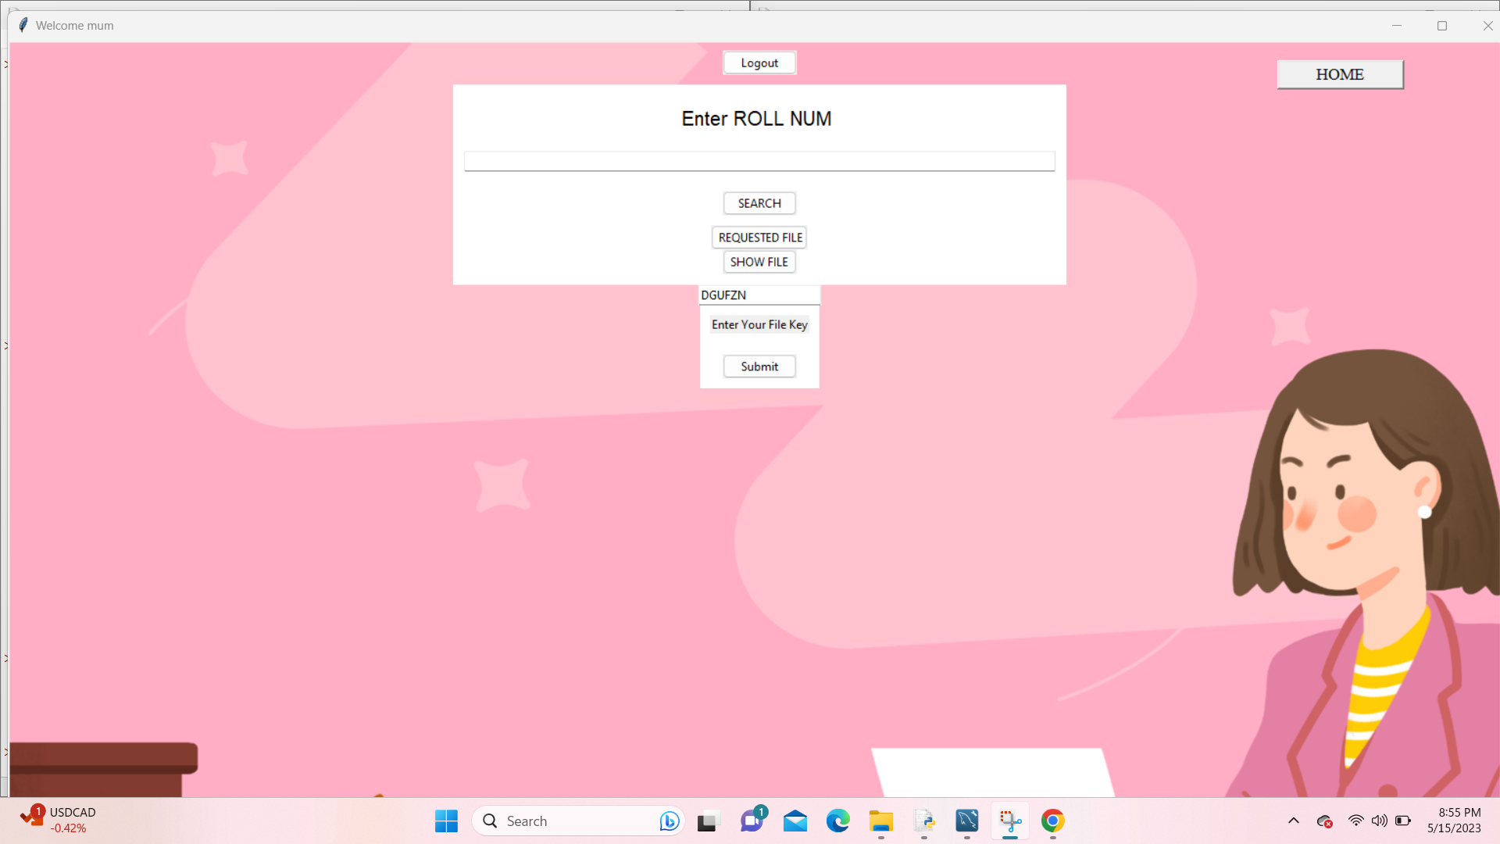
Result Analysis
User Requested File
Enters teacher approved uniqe key

Slide 29
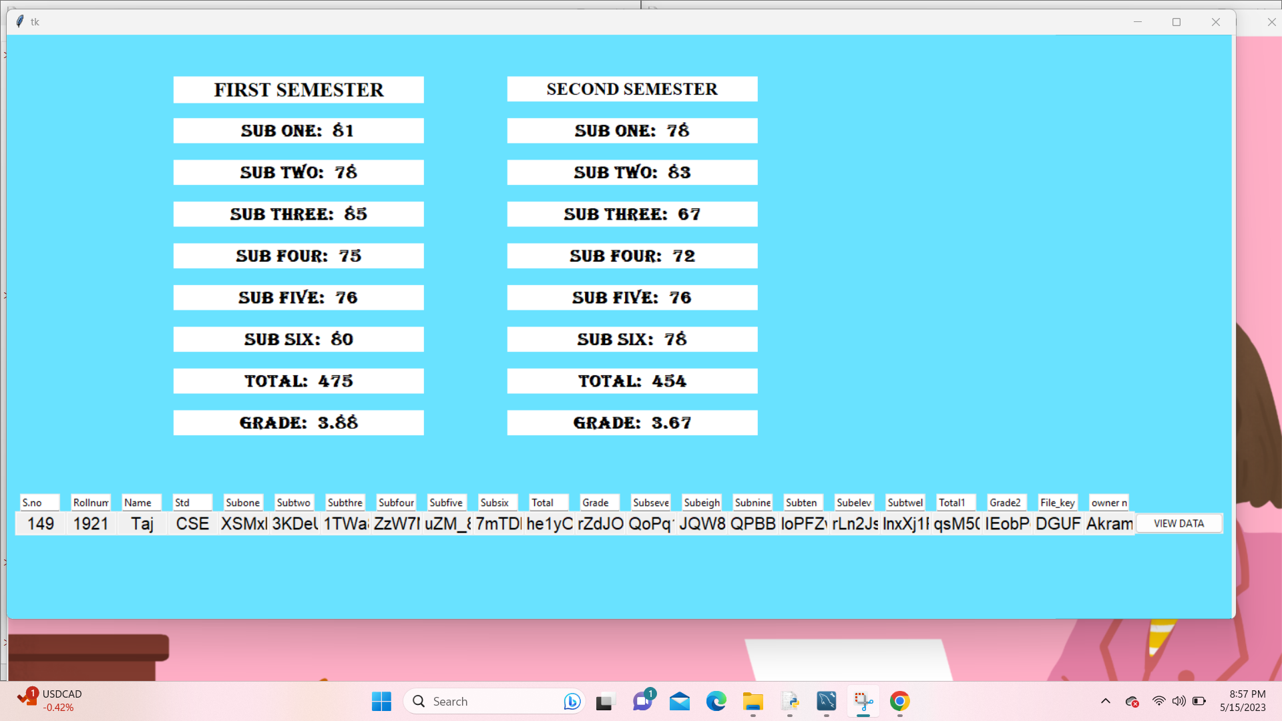
Result Analysis
Access to Encrypted data
Enter Show Button & Seen Academic data

Slide 30
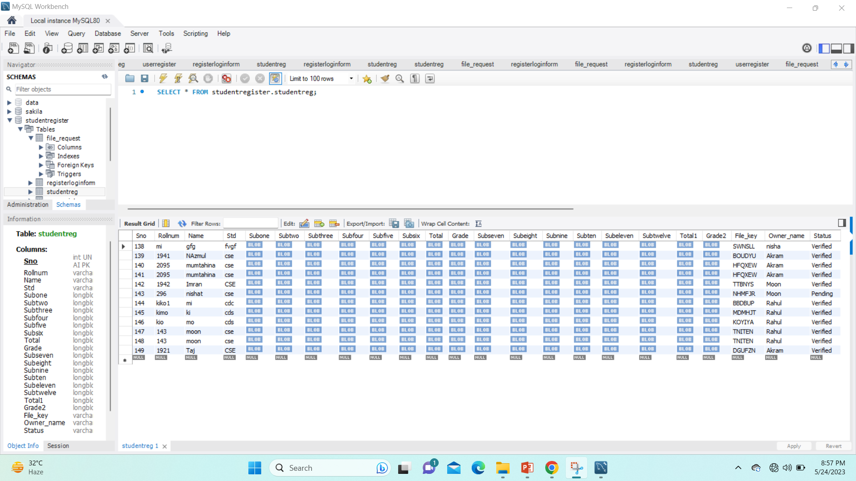
Result Analysis
Stored Database

Slide 31
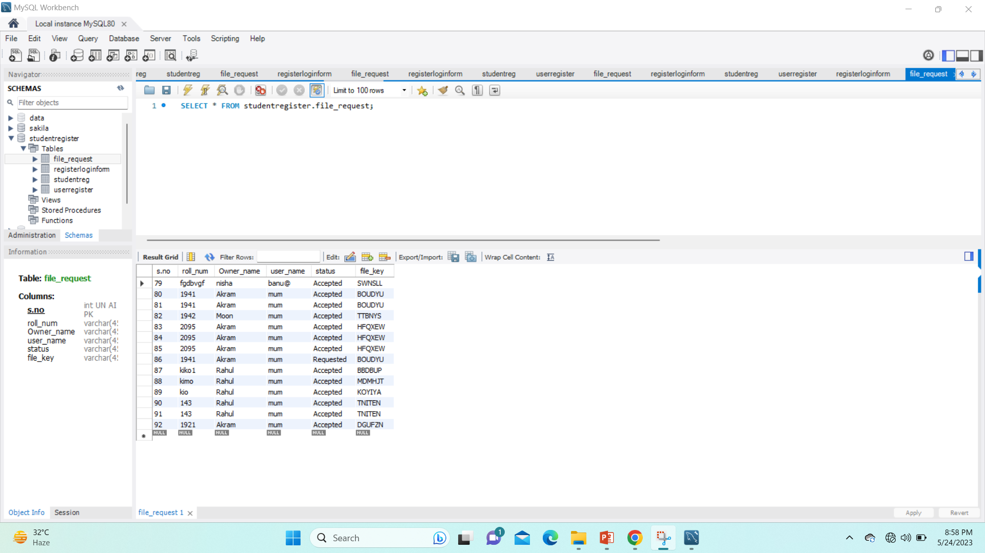
Result Analysis
Stored Database

Slide 32
Conclusion and Future Scope
Conclusion
Future Scope
The EduRSS scheme proposes a secure storage and sharing solution for educational records using blockchain technology, ensuring data integrity and security through a consortium chain and distributed institution authentication. The scheme combines blockchain and storage server for secure storage, and employs an anti-tampering inspection mechanism for record protection.
Further research can focus on optimizing performance and scalability, enhancing privacy with advanced encryption techniques, incorporating smart contracts or digital signatures, real-world implementation, and evaluating effectiveness in different educational settings to validate the practicality and identify potential challenges.

Slide 33
References
[1]“Review of major global data leakage events in the first half of 2020,” https://www.isccc.gov.cn/xwdt/xwkx/07/903972. shtml, January 2020.
[2]H. Li and D. Han, “Edurss: A blockchain-based educational records secure storage and sharing scheme,” IEEE Access, vol. 7, 2019, pp. 179 273–179 289.
[3]C. Wang, S. Chen, et al., “Block chain-based data audit and access control mechanism in service collaboration,” in 2019 IEEE International Conference on Web Services (ICWS), 2019, pp. 214– 218.
[4] Z. Li and Z. Ma, "A blockchain-based credible and secure education experience data management scheme supporting for searchable encryption," in China Communications, vol. 18, no. 6, pp. 172-183, June 2021, doi: 10.23919/JCC.2021.06.014.
[5] Shilpashree B N , Rohini Krishna Mohite , Sahana S , Rajesha, Rakesh K R, 2021, Counterfeit Detection of Documents using Blockchain, INTERNATIONAL JOURNAL OF ENGINEERING RESEARCH & TECHNOLOGY (IJERT) Volume 10, Issue 07 (July 2021),
[6]Jayesh G. Dongre , Sonali M. Tikam , Vasudha B. Gharat , Dr. Kishore T. Patil, 2020, Education Degree Fraud Detection and Student Certificate Verification using Blockchain, INTERNATIONAL JOURNAL OF ENGINEERING RESEARCH & TECHNOLOGY (IJERT) Volume 09, Issue 07 (July 2020),
[7]Elva Leka and Besnik Selimi, “Development and Evaluation of Blockchain based Secure Application for Verification and Validation of Academic Certificates”, Annals of Emerging Technologies in Computing (AETiC), Print ISSN: 2516-0281, Online ISSN: 2516-029X, pp. 22-36, Vol. 5, No. 2, 1st April 2021, Published by International Association of Educators and Researchers (IAER), DOI: 10.33166/AETiC.2021.02.003, Available: http://aetic.theiaer.org/archive/v5/v5n2/p3.html. Review Article.
[8]Poja Mara, Ravi Kanth Motupalli., “Blockchain-based model to track and verify official certificates.” Website: ijetms.in Issue: 1 Volume No.6 January – 2022 DOI: 10.46647/ijetms.2022.v06i01.002 ISSN: 2581-4621
[9]Harshita Bhosale1, Rutuja Kanki, Gayatri Jaiswal , “Revolutionizing Verification and Management of Educational Certificates with Self-Sovereign Student Identities using Blockchain.” Year:2021.
[10]A. F. M. S. Akhter, M. Ahmed, et al., “A secured privacypreserving multi-level blockchain framework for cluster based vanet,” Sustainability, vol. 13, no. 1, 2021, p. 400.
[11]H. Huang, P. Zhu, et al., “A blockchain-based scheme for privacy- preserving and secure sharing of medical data,” Computers & Security, vol. 99, 2020, p. 102010.
[12]Y. Xue, K. Xue, N. Gai, J. Hong, D. S. L. Wei, and P. Hong, ‘‘An attributebased controlled collaborative access control scheme for public cloud storage,’’ IEEE Trans. Inf. Forensics Security, vol. 14, no. 11, pp. 2927–2942,Nov. 2019.
[13]X. Feng, P. Deng, et al., “Verifiable decentralized access control for distributed databases,” in 2020 International Conference on Cyber- Enabled Distributed Computing and Knowledge Discovery (CyberC), 2020, pp. 248.
[14]B. Pillai and K. Biswas, “Cross-chain interoperability among blockchain-based systems using transactions,” Knowledge Engineering Review, vol. 35, 2020, p.1.
[15]A. Derhab, M. Guerroumi, A. Gumaei, L. Maglaras, M. A. Ferrag,
M. Mukherjee, and F. A. Khan, ‘‘Blockchain and random subspace learning-based IDS for SDN-enabled industrial IoT security,’’ Sensors, vol. 19, no. 14, p. 3119, 2019.
[16]A. Wu, Y. Zhang, X. Zheng, R. Guo, Q. Zhao, and D. Zheng, ‘‘Efficient and privacy-preserving traceable attribute-based encryption in blockchain,’’ Ann. Telecommun., vol. 74, nos. 7–8, pp. 401–411, Aug. 2019.

Slide 34


